Slide 1
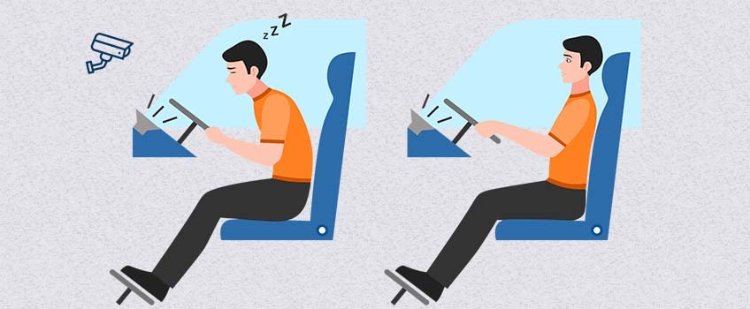
DOZY DRIVING DETECTION SYSTEM
TEAM MEMBERS:
M. Sushma (1602-19-737-117)
G. Suma Sri (1602-19-737-116)
C. Srilatha (1602-19-737-113)

Slide 2
ABSTRACT
In recent years, the rise of accident fatalities has grown significantly around the world. Drowsy driving is a controversial topic when coming to road safety. Nearly everyone who drives a car on a regular basis already experienced drowsiness or even micro-sleeps during driving. Hence, road security has become a global concern and a challenging problem that needs to be solved. Drowsiness comes along with cognitive impairments that are particularly dangerous during driving. Decades of research have identiﬁed measures that enable a driver state determination.. The behavior of a drowsy driver shows phenomena like increased frequencies of head nodding, yawning and eye blinking as well as more frequent body movements in general(like scratching the head and face or moving the legs). A countless number of people drive on the highway day and night. Taxi drivers, bus drivers, truck drivers and people traveling long-distance suffer from lack of sleep.

Slide 3
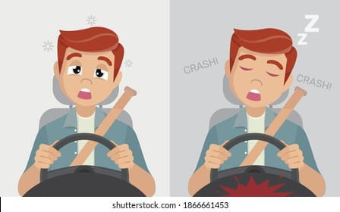
INTRODUCTION
Drowsy Driving is a deadly combination of driving and sleepiness. The number of road accidents due to Drowsy Driving is increasing at an alarming rate worldwide. Not having a proper sleep is the main reason behind drowsiness while driving. However, other reasons like sleep disorders, medication, alcohol consumption, or driving during night shifts can also cause drowsiness while driving.According to a report of AIIMS Neurology India —Sleep Disorders became the reason behind around more than 20% of all road accidents and around 23% of truck drivers have sleep deprivations.Whatever be the reason for drowsiness, the fatalities due to drowsy driving are increasing every year.

Slide 4
SOFTWARE REQUIREMENTS
Front end:
Python
Back end:
Dataset
Framework:
Machine Learning
(Open CV, Keras, Tensor Flow)

Slide 5
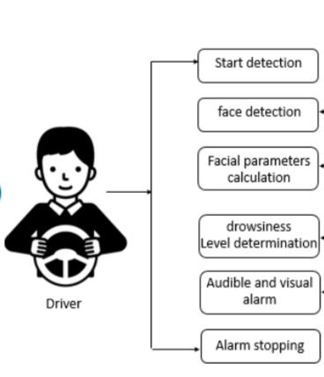
DESIGN OF SOLUTIONS ARCHITECTURE
.

Slide 6
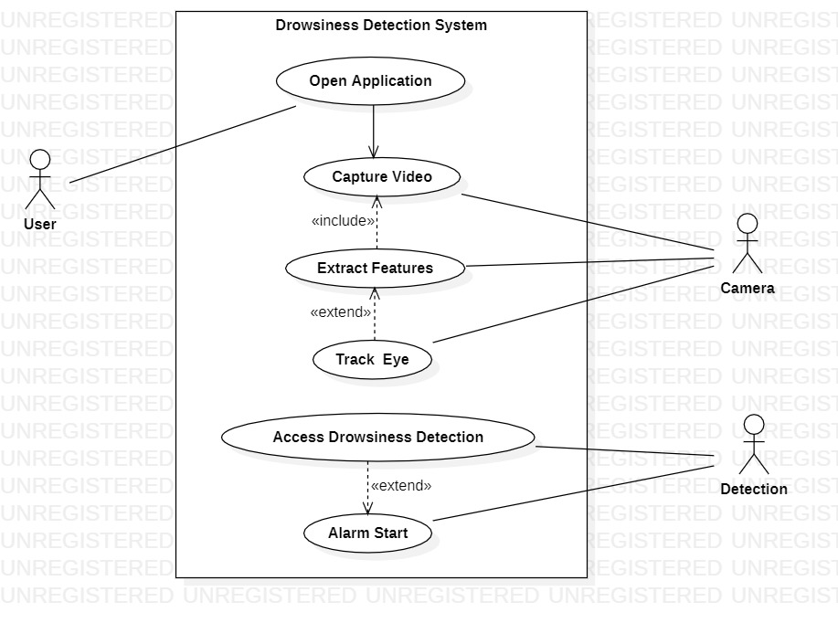
USE CASE DIAGRAM

Slide 7
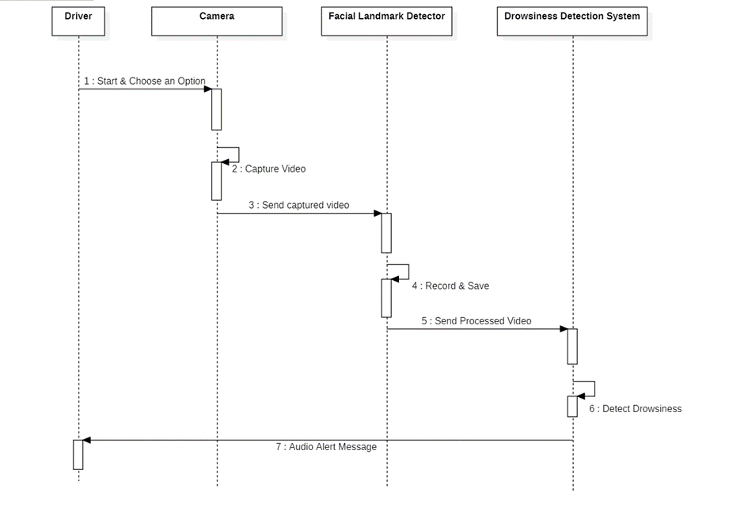
SEQUENCE DIAGRAM:

Slide 8
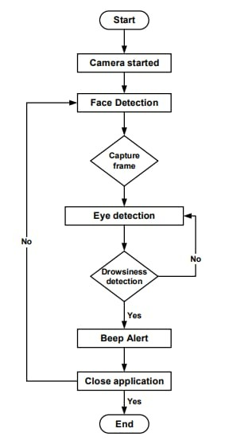
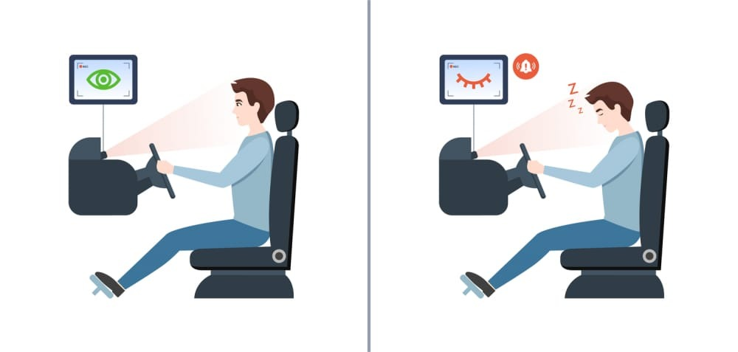
FLOWCHART

Slide 9
TECHNOLOGY USED
MACHINE LEARNING
Machine learning is the kind of programming which gives computers the capability to automatically learn from data without being explicitly programmed.
In other words that these programs change their behaviour by learning from data. Python is clearly one of the best languages for machine learning.
Face Recognition

Slide 10
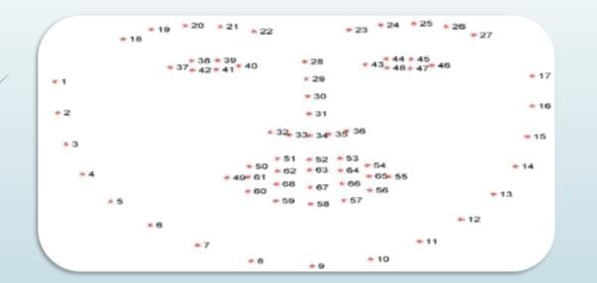
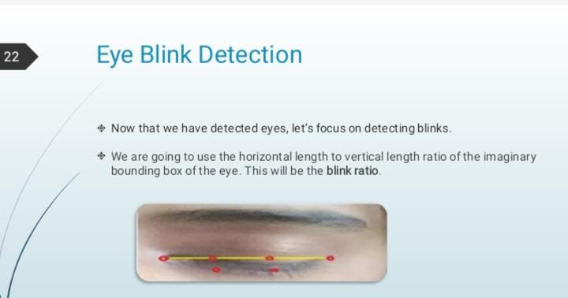

Slide 11
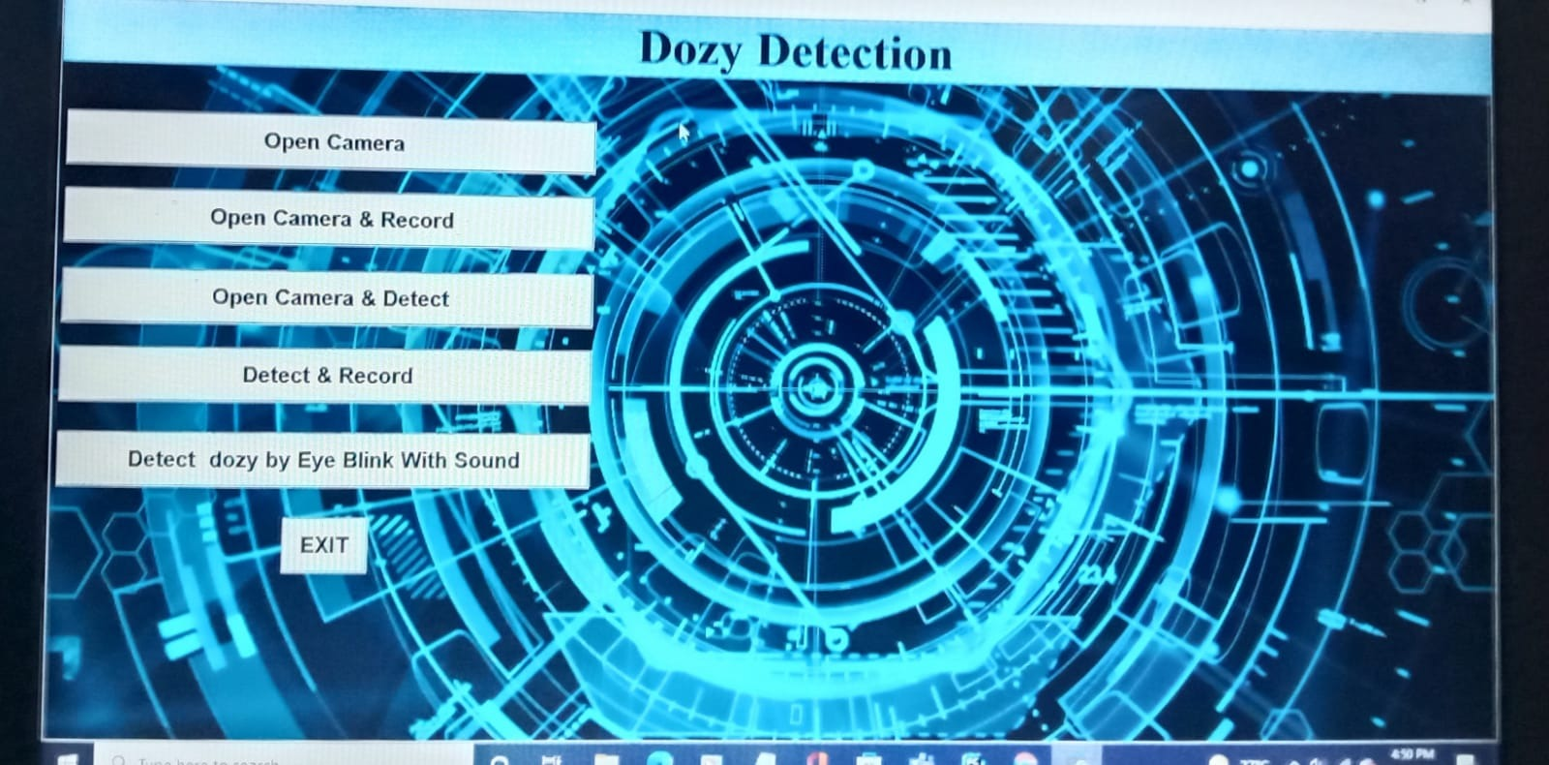
RESULT

Slide 12
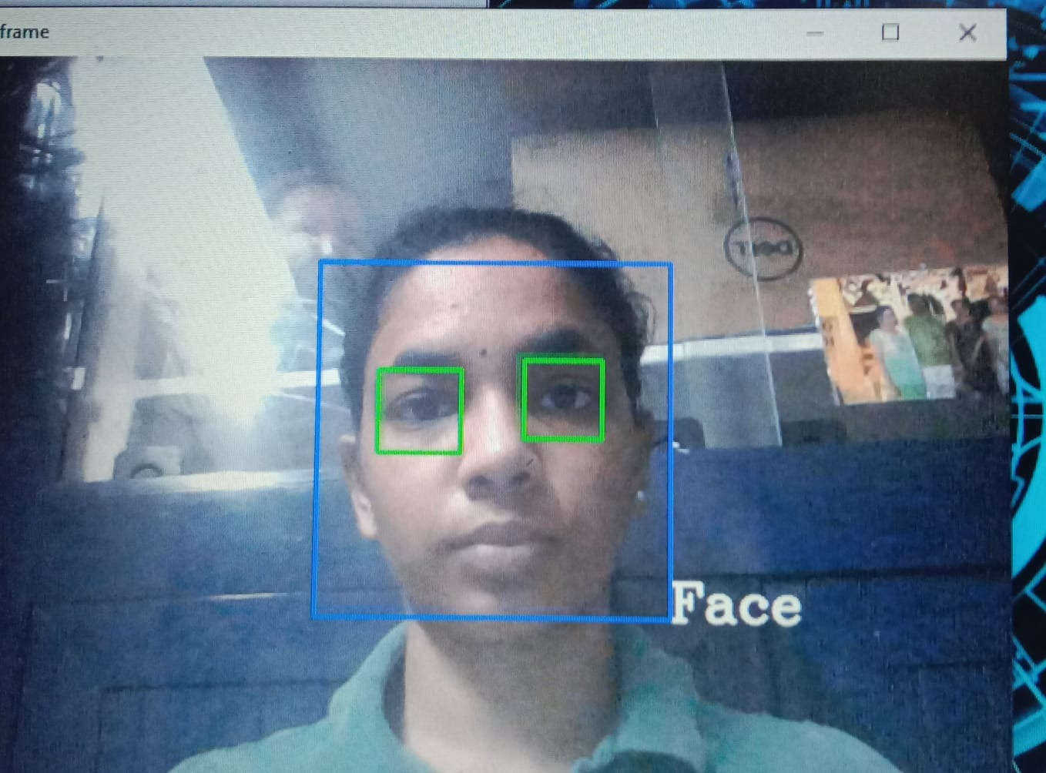
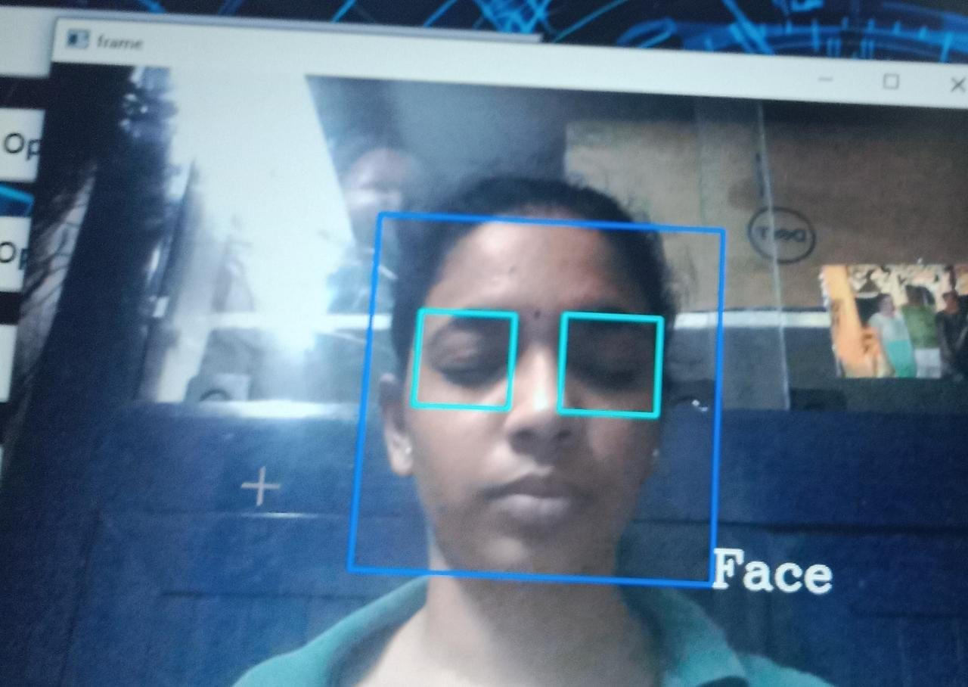

Slide 13
CONLUSION
The current study developed an automated system for detecting drowsiness of the driver. The continuous video stream is read from the system and is used for detecting the drowsiness. It is detected by using haar cascade algorithm. The haar cascade algorithm uses haar features to detect face and eyes. Haar features are predefined are used for detecting different things. The haar features are applied on the image and blink frequency is calculated using perclos algorithm. If the value remains 0 for some amount of time then it detects as sleepy and alerts driver by activating an alarm. If the value remains constant for longer periods then the driver is said to be distracted then also an alarm is activated.

Slide 14

FUTURE SCOPE
The work can be extended by extracting the features of mouth where the driver can be detected as drowsy through yawning. If the driver yawns repeatedly for more number of times then we can say that he is in sleepy mode. If the number exceeds a limit then we can alert the driver. This work can also be extended by implementing in full night light using IR web cam. It is camera which uses infrared radiations to detect whether the person is drowsy or not.
While this is a research project, there is scope when this completely turns out to be developed into an application which can be run by the end users on their own for their own purposes on their own systems.

Slide 15
REFERENCES
Global Status Report on Road Safety , [online] Available:
http://www.who.int/violence_injury_prevention/road_safety_status/2013/en/index.html.
Z. Ngcobo, Over 1700 people died on SA roads this festive season,
2019, [online] Available:
http://ewn.co.za/2017/01/10/over-1-700-people-died-on-sa-roads- this-festive-season.
https://ieeexplore.ieee.org/document/8261140

Slide 16


